Slide 1
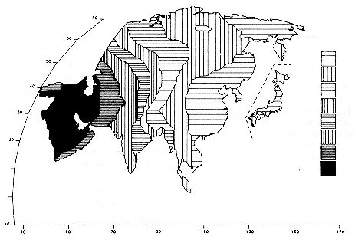
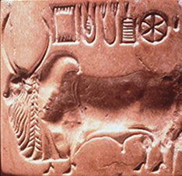
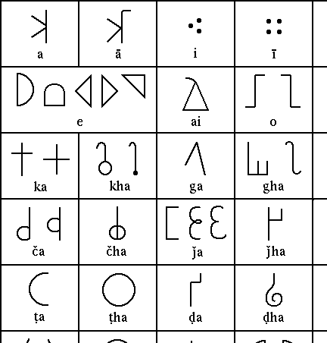
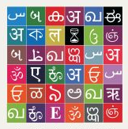
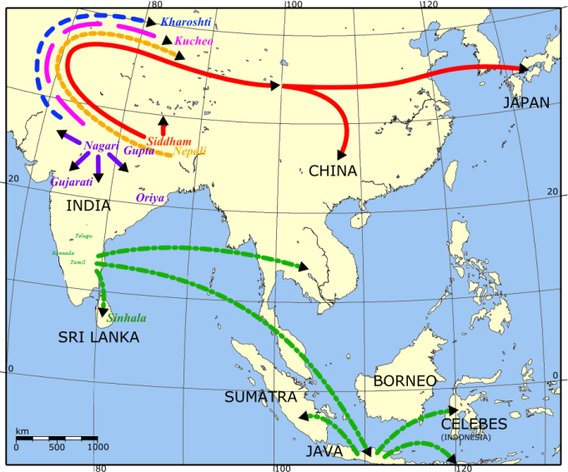
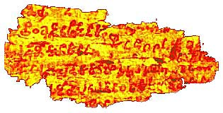
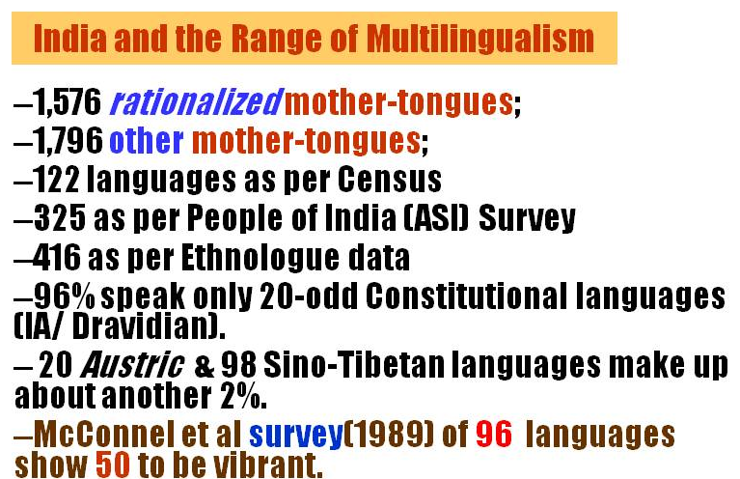
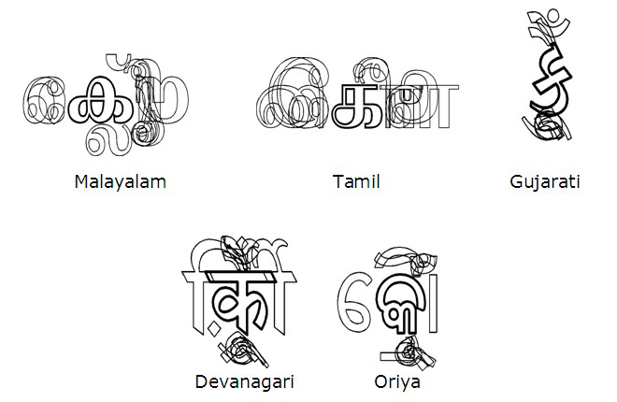
South Asiais perhaps one of the largest repository of multi-lingual & pluri-ethnic civilization, dating back to 2600 and 1900 BC. This Indus Valley Civilization was spread over India, Pakistan, and Afghanistan. Many inscribed seals found there are difficult to trace them to their origin or linkages Aryan/ Austric/ Dravidian or Unrelated? Both Brāhmī (5th CBC)& Kharoşţhī (4thCBC) scripts prevailed – resulting in a rich tapestry of scripts →
Brāhmī spread
to many Asian nations
What is known as the Indo-European family of languages came to the present cultural space called ‘South Asia’ about 3800 years ago, from the oases south of the Urals, north of the Black Sea and in western Kazakstan moved west-ward & east-ward to the south, mixing with the Indigenous linguistic groups in India - the Dravidian and the Austro-Asiatic speakers. The Sino-Tibetan or the Tibeto-Burman ethno-linguistic groups also arrived from the northern neighbors, and settled down in the North-Eastern region.
What neo-brahmi scripts look like today
Each indigenous writing system in India has numerous difficulties/ nuances because of the way the sounds/ syllables are captured.

